Slide 1
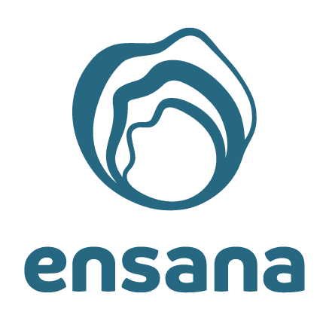
Healing Power of Nature

Slide 2
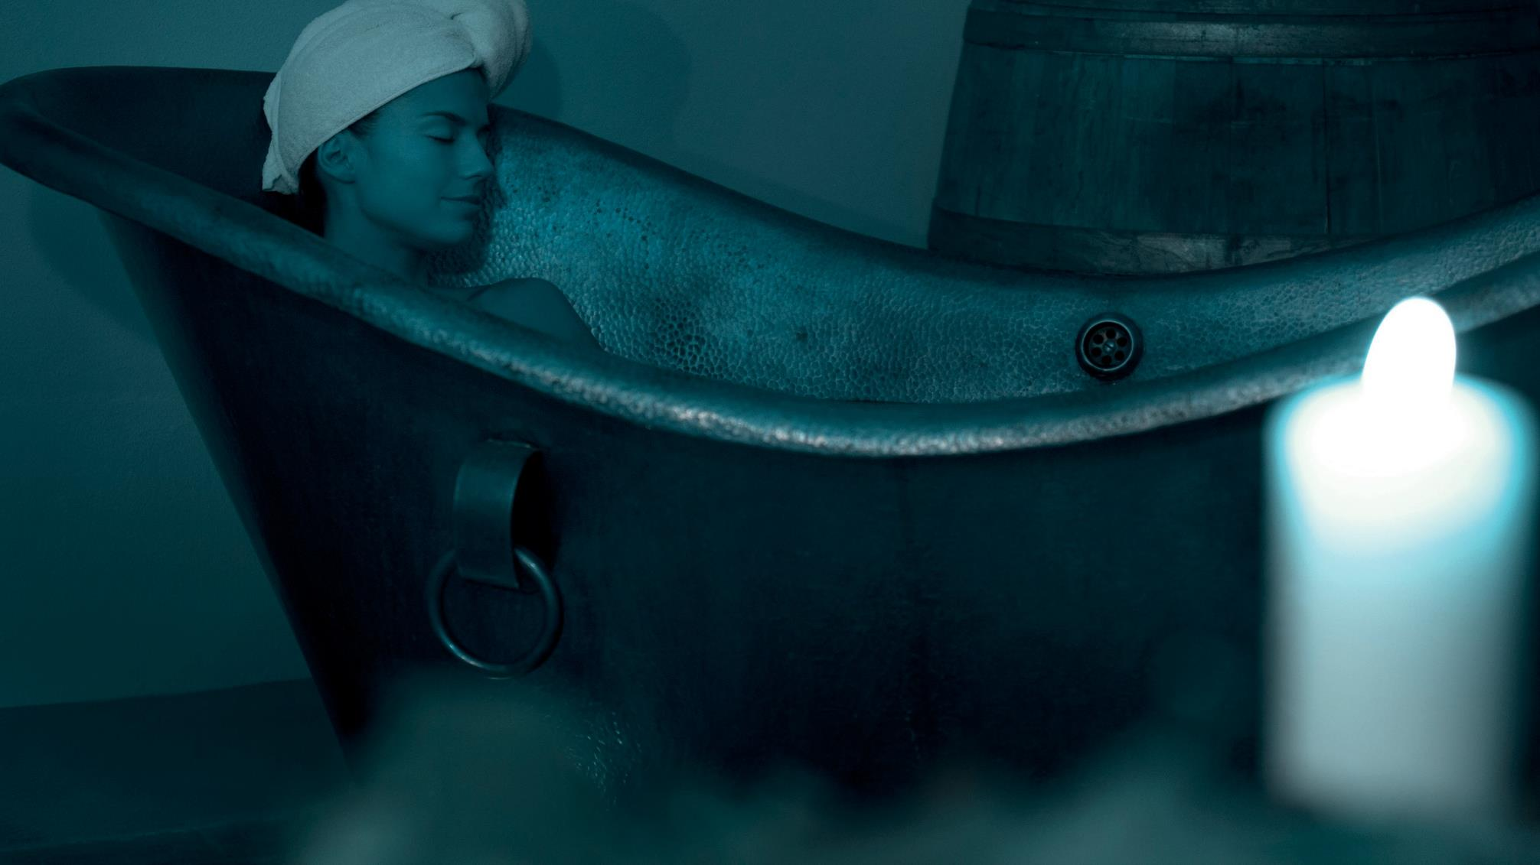
Introduction
Ensana Health Spa Hotels
Where natural medicine meets hospitality
At Ensana, Europe’s leading health spa, we offer a truly unique opportunity for your health and happiness.
Our wide collection of spa hotels celebrates the power of local natural resources for your physical well-being and emotional balance.
We combine the healing properties of thermal and mineral waters, muds and other natural resources with a history of proven medical expertise and modern diagnostic methods.
And we share this with guests in historic places of culture & beauty in eleven destinations across Europe.

Slide 3
Our vision
We are Europe’s leading health spa operator
With the combination of powerful natural resources, medical expertise and integrative health concept we aspire to help our guests to live a healthier life.

Slide 4
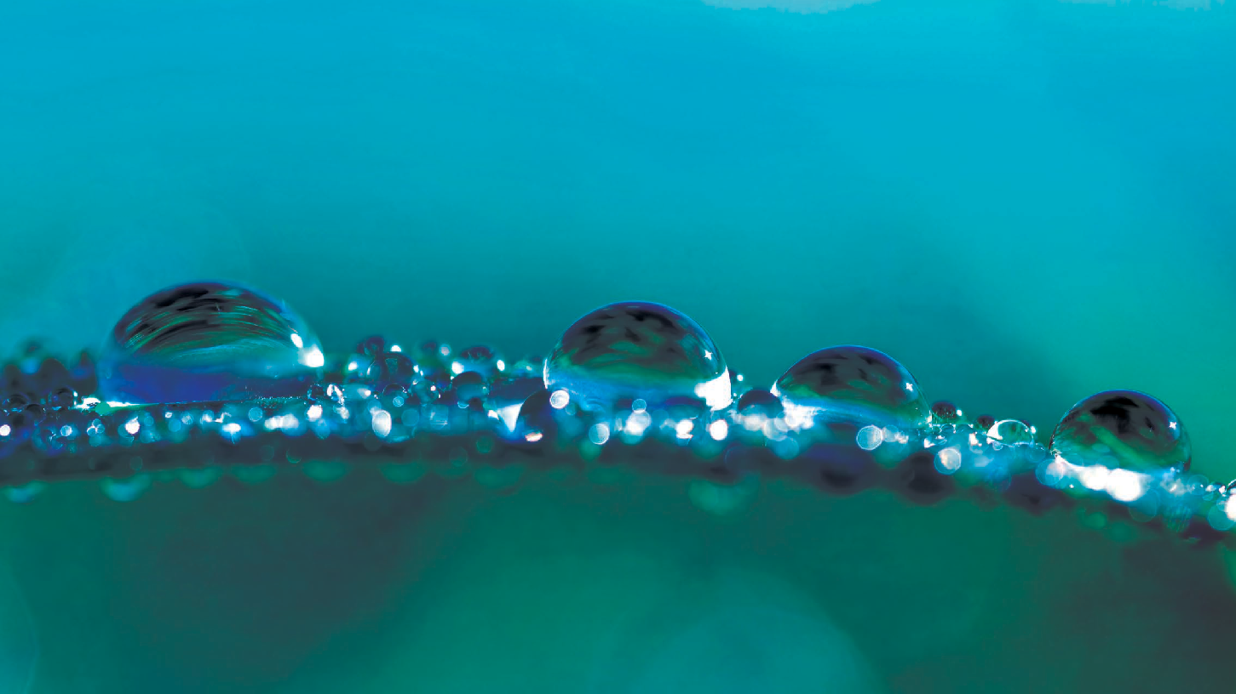
Ensana values
WE ARE CARING
We go out of our way to ensure the comfort and well-being of our guests and employees
WE ARE INCLUSIVE
All those who have the desire and drive to improve their health are welcome with us.
No matter what service level our guests are aiming for or what budget they have for their stay, our diverse range of hotels has something for every health-conscious person
WE ARE COMMITTED
We are committed to the health and well-being of our guests. Our extensive knowledge and vast experience enable us to help them achieve measurable personal results.
We never stop being curious and with our innovative spirit we will continue to evolve and improve our offerings to always meet their needs.

Slide 5
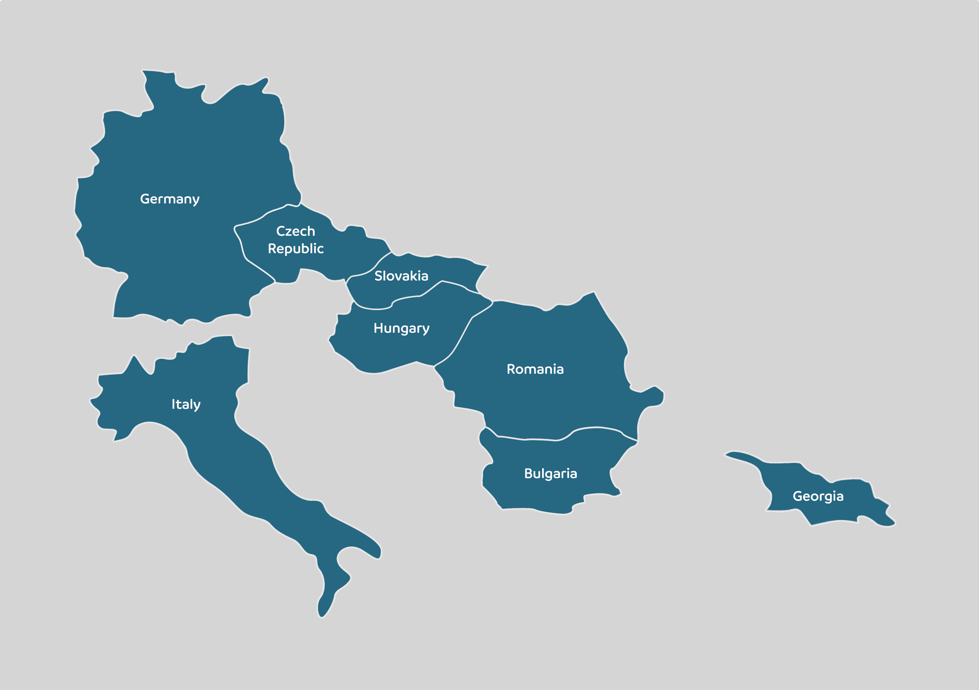
Ensana destinations
8 countries – 11 locations – 26 hotels
Bulgaria Sts Constantine & Helena (1)
Czech Republic Marienbad (7)
Georgia Sairme (2) OPENING SOON
Germany Bad Griesbach (1) OPENING SOON
Hungary Budapest (2)
Heviz (2)
Sarvar (1)
Italy Montegrotto Terme (1) OPENING SOON
Romania Sovata (3)
Slovakia Piestany (5)
Smrdaky (1)

Slide 6
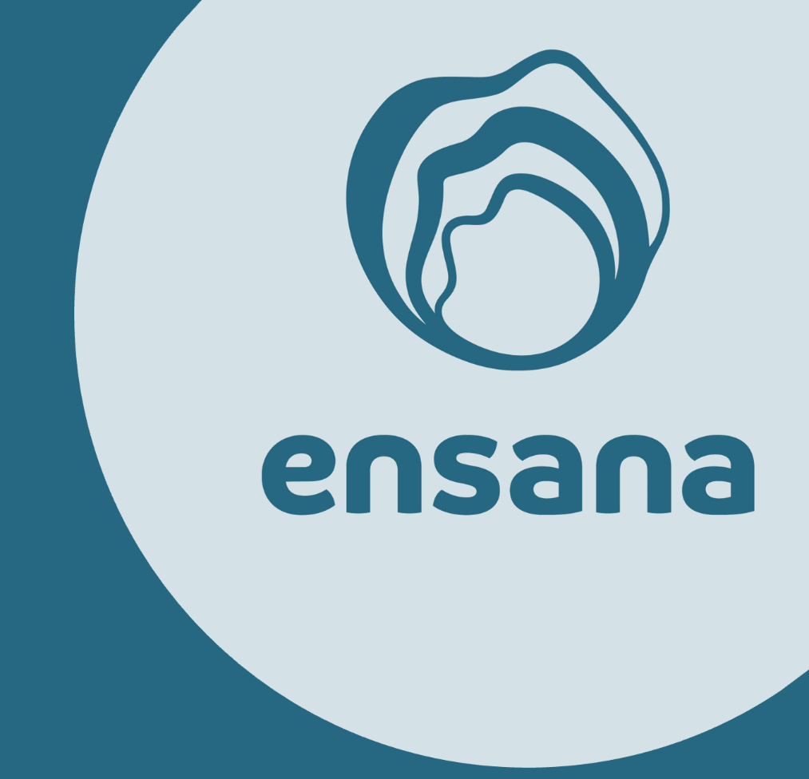
KPIs of Ensana
Destinations / Hotels 8 / 11 / 26
Number of rooms 4.050
Number of guests 290.000
Room nights 1.6 million
Employees 2.500
Treatments 2 million
Awards (2021) ESPA INNOVATION AWARD WINNER
Post-Covid research, study and programme
Awards (2022) STEVIE® AWARD WINNER
Company of the Year - Hospitality and Leisure - Large
GLOBEE® WINNER
Employer of the year – Hospitality, Travel, Recreation, and Leisure
Awards (2023) GLOBEE® WINNER
Employer of the year – Hospitality, Travel, Recreation, and Leisure
Awards (2024) GLOBEE® AWARD WINNER
Company of the year – Hospitality, Travel, Recreation, and Leisure
Awards ( 2025 ) BEST SEASIDE 5* SPA HOTEL BULGARIA
Ensana Aquahouse
GLOBEE® AWARD WINNER
Company of the year – Hospitality, Travel, Recreation, and Leisure

Slide 7
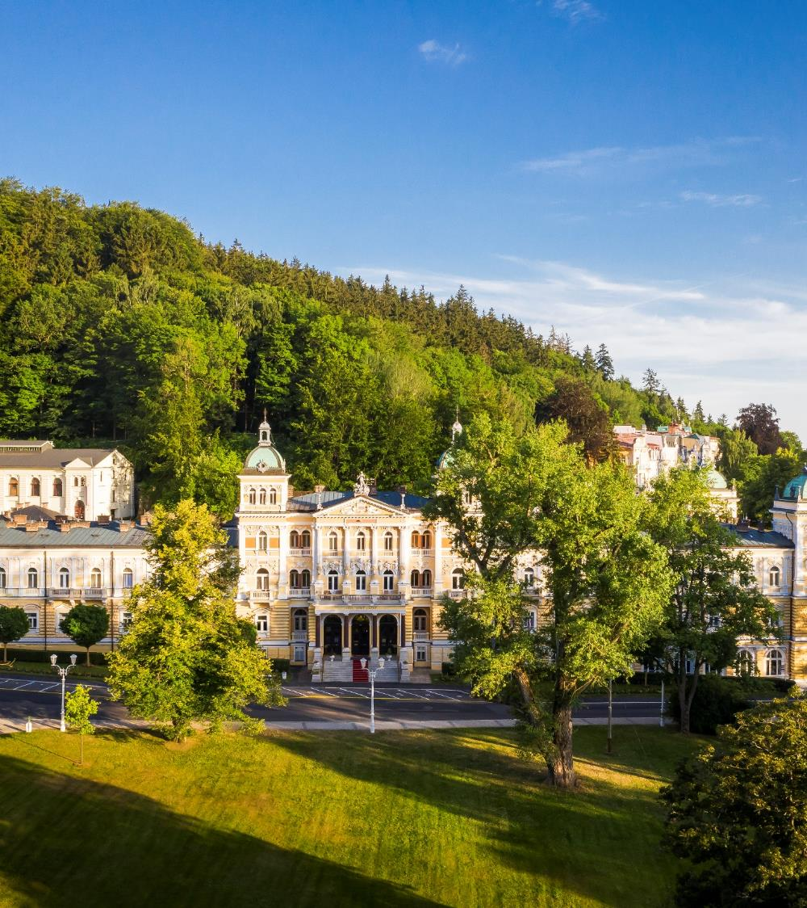
Mariánské Lázně, Czech Republic
7 Ensana health spa hotels
Mariánské Lázně is the model European spa town with its defining blend of healing natural resources, architectural splendour and more than 200 years of famous visitors such as Chopin, Goethe and King Edward VII whose Royal Cabin still exists in our hotel Nové Lázně.
The town has recently been inscribed on UNESCO’s World Heritage List as one of eleven Great Spa Towns of Europe. Marienbad’s unique local natural healing resources:
40 different cold mineral water springs rich in calcium, magnesium, iron, carbon dioxide or salt
Natural bog and peat muds, harvested from around the mineral water springs
Natural CO² gas

Slide 8
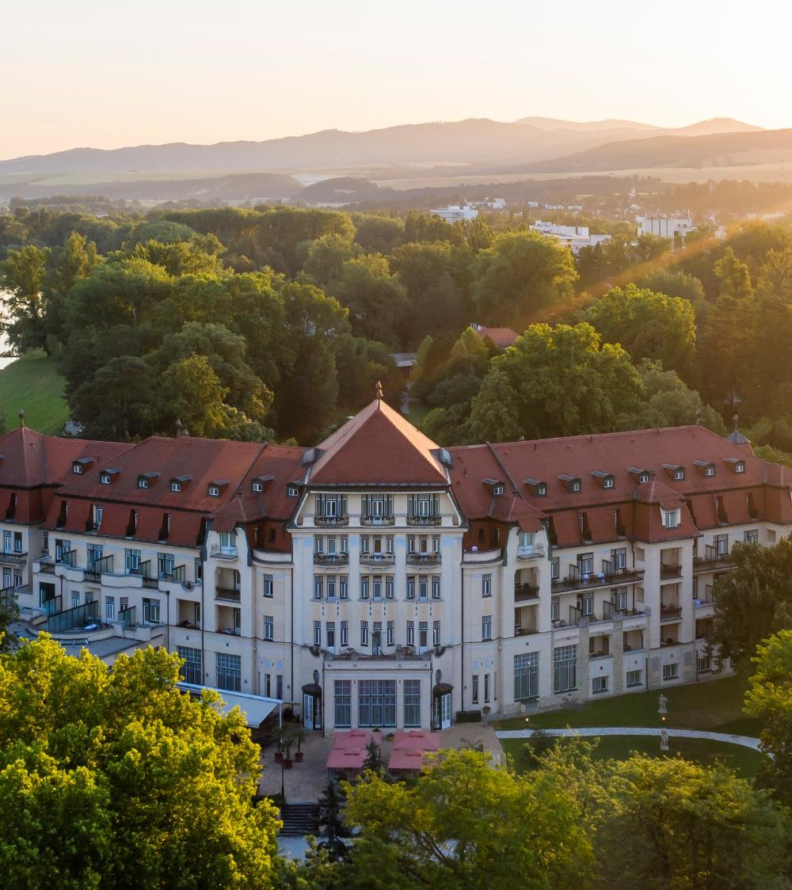
Piešťany, Slovakia
6 Ensana health spa hotels
A beautifully landscaped island, in the middle of Slovakia’s River Váh, with a collection of Ensana health spa hotels, spa and balneo centres offering more than 60 treatments.
Spa Piešťany has been famous for more than 100 years for its success in the treatment of musculoskeletal disorders and rheumatism.
Unique natural healing resources - 69°C thermal mineral water, healing sulfur mud.

Slide 9
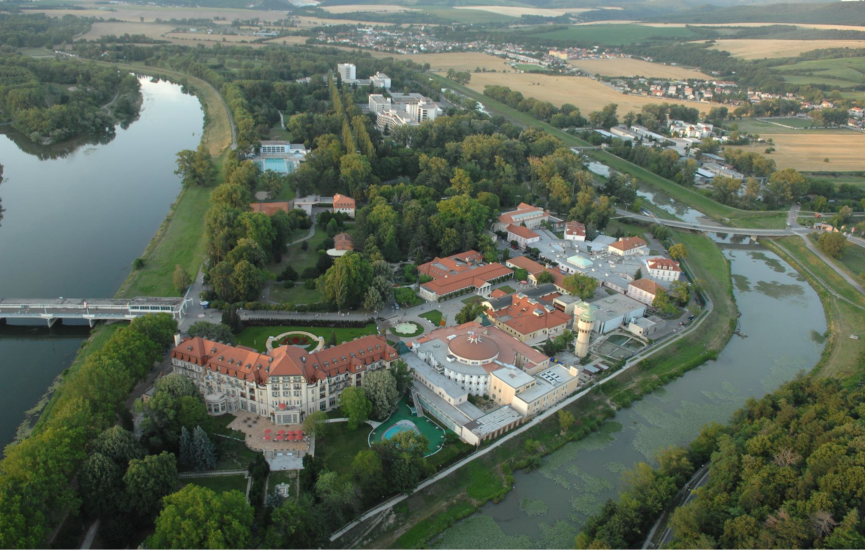
Splendid
Balnea
Esplanade
Pro Patria
Napoleon
Thermia Palace
Irma Spa

Slide 10
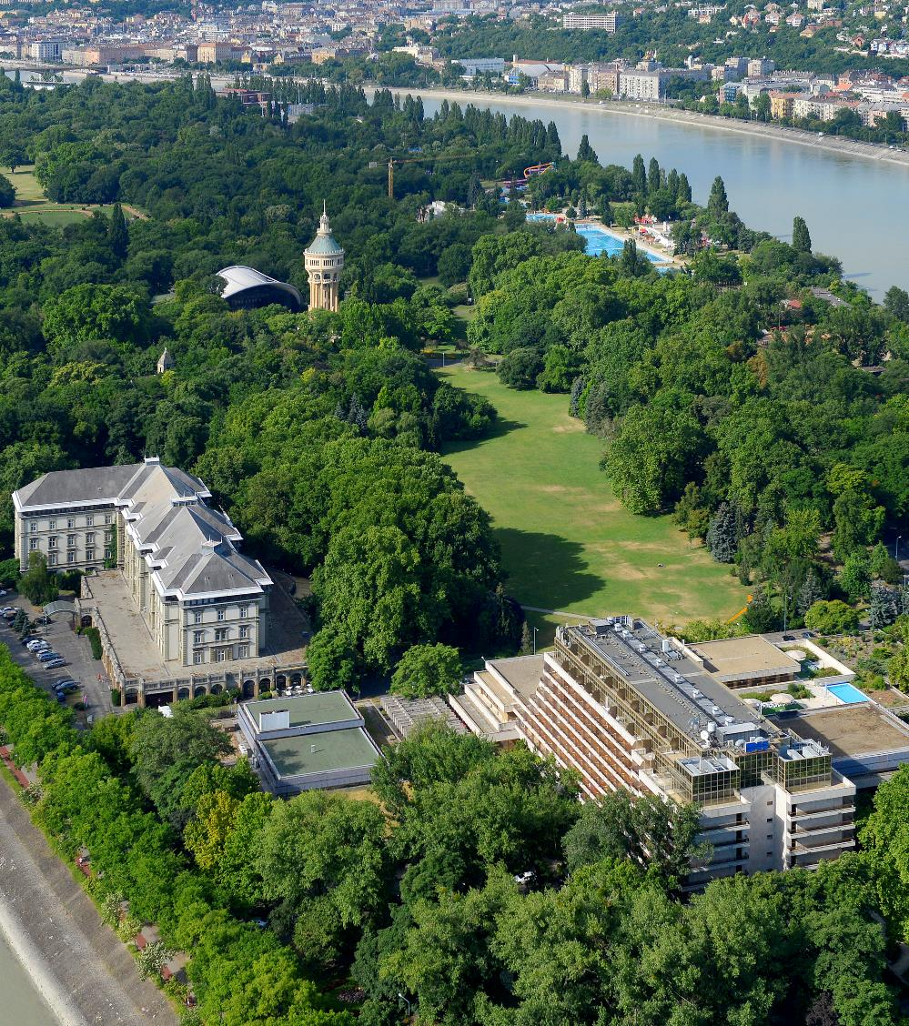
Budapest, Hungary
2 Ensana health spa hotels
Ensana has two stunning spa hotels, with their own springs, all on the two and half kilometre, green and landscaped Margaret Island, in the middle of the River Danube. It is an ideal place to escape the bustle of the city.
The city center is accessible in 15 minutes by regular public transport or taxi.
Budapest’s natural therapies treat all kinds of inflammatory conditions.
The city’s thermal water is also perfect for relaxation and stress relief.

Slide 11
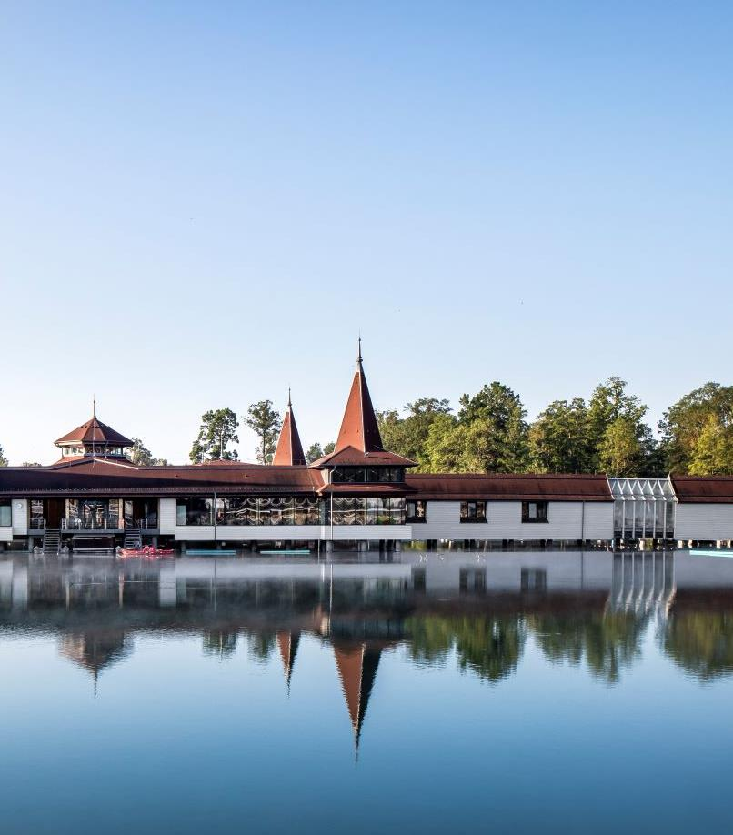
Hévíz, Hungary
2 Ensana health spa hotels
A rare biologically-active lake of healing
Hévíz is home to the largest thermal lake in the world, suitable for bathing, where guests can enjoy year-round wellbeing thanks to the Mediterranean climate and perfectly warm, mineral-rich water.
Year-round thermal water (always more than 23 degrees Celsius, whatever the season) with active health properties.
The city features a rich cultural program from culinary events and water sports, to local wine tasting, hiking and even hot-air balloon activities.

Slide 12
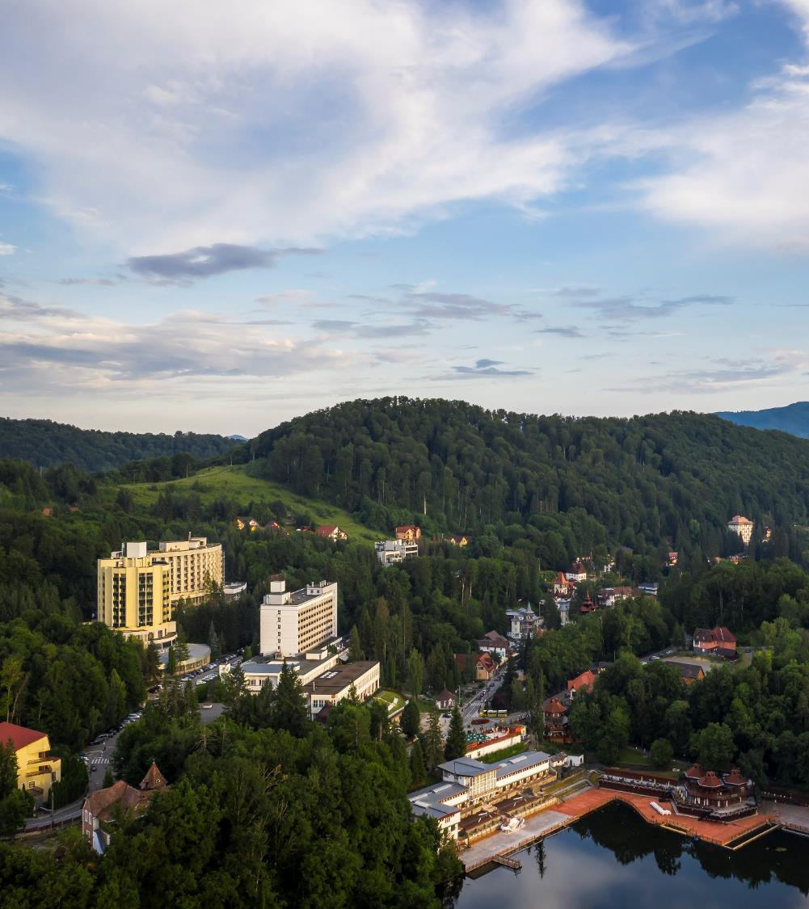
Sovata, Romania
3 Ensana health spa hotels
Sovata is home to the largest heliothermic lake in Europe. It’s a place where naturally-occurring salt water and the sun’s heat allow warm water bathing surrounded by outstanding natural beauty.
Wildly romantic countryside, beautiful wooden villas built in the 19th century and a naturally warm lake make Sovata an ideal place to relax and recharge. Sovata has always been known as ‘the town where women are happy’, such are the remarkable effects of its natural resources on female health.
The healing power of Sovata's mineral water has been known for 500 years. It was in the 19th century, that a natural sinkhole created the famous Bear Lake, for which this small mountain town is so famous.

Slide 13
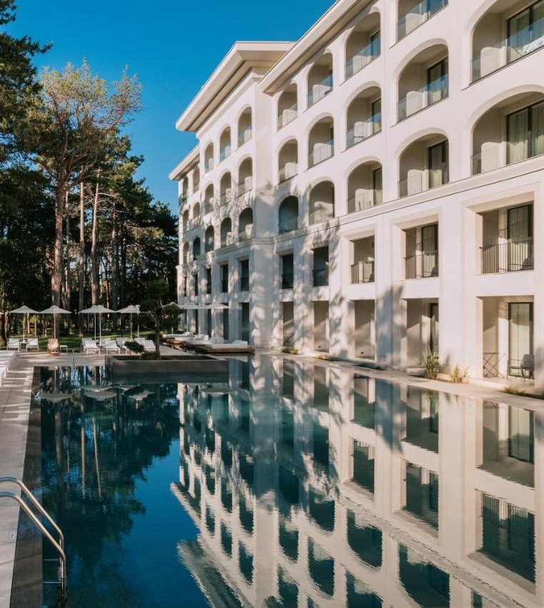
Sts Constantine & Helena, Bulgaria
1 Ensana health spa hotel
Aquahouse Hotel & Spa is located in the resort Sts. Constantine and Helena, 25 meters away from the beach. The architecture is inspired by the nature, the sea waves and the sand curves. The harmony of natural colors creates the sensation of elegance and an irresistible feeling for something yours. Newly-open in 2022, surrounded by pine trees, combines modern luxury with natural resources.
Mineral & thermal water as a natural resource
hyperthermal 46⁰С, mineralized water
total mineralization of 553 mg/l
(hydrocarbonate, sodium-calcium-magnesium)
suitable for a variety of therapeutic applications

Slide 14
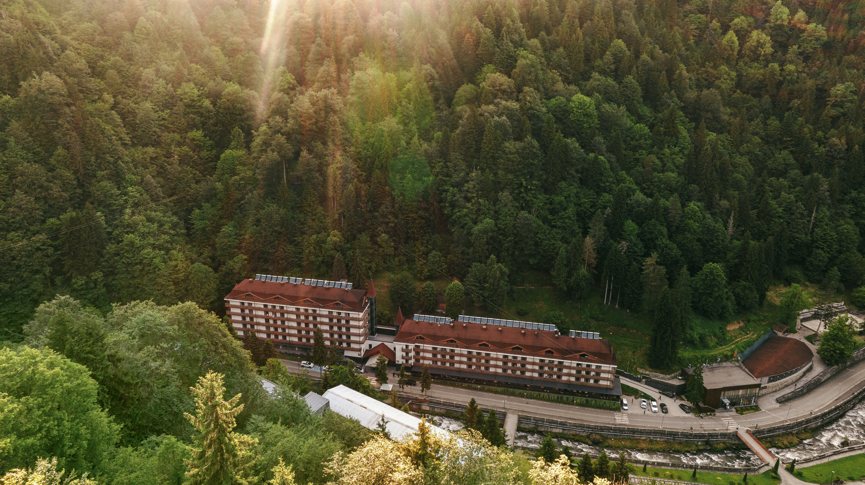
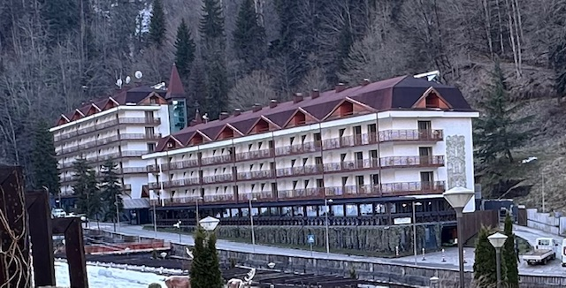
Sairme Resort, Georgia
At Sairme Resort, the core values revolve around physical activity, rehabilitation, relaxation, and mental well-being. The resort provides a unique opportunity to take full advantage of balneological interventions.
The area is being reach in four kinds of mineral water which have positive effect on:
Kidney stones, urinary tract infections, diabetic neuropathies, diabetes, digestive disorders, chronic fatigue, menopausal symptoms, upper respiratory infections, eczema, psoriasis, acne, detox programs and age-related health challenges

Slide 15
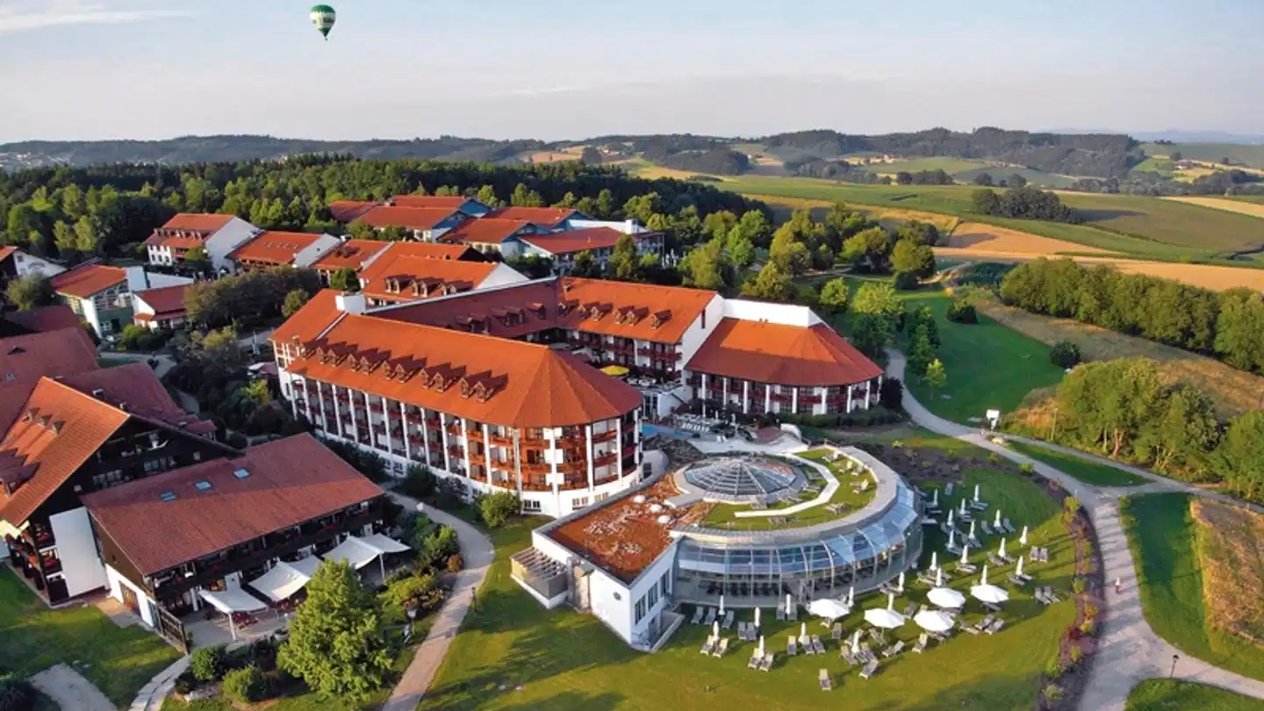
Bad Griesbach, Germany
1 hotel
Nestled in Bad Griesbach’s spa region, the Fürstenhof will undergo an extensive renovation. The refurbishment will introduce state-of-the-art spa facilities, advanced medical and diagnostic services, and upper upscale accommodations, all designed to harness the region’s natural thermal springs and healing resources.
Guests can expect a holistic experience combining Bad Griesbach’s mineral-rich waters with Ensana’s centuries of expertise in integrative medicine and natural therapies.
Strategically located within Europe’s largest golf resort, the Fürstenhof Hotel offers unparalleled access to world-class golfing facilities as well.

Slide 16

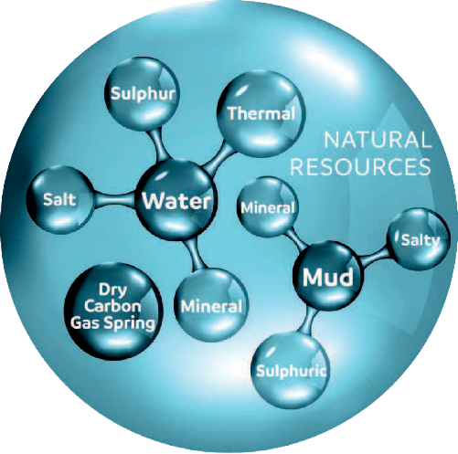
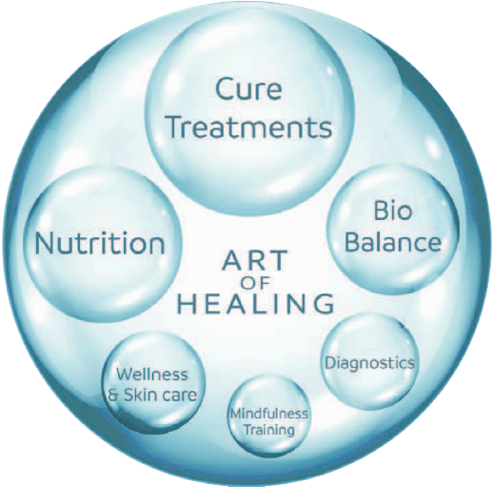
The Health Spa Concept
Our distinctive medical concept combines the curative power of natural resources with our long-held experience in medicine. We have an integrative approach to the health and well-being of our guests.
The healing properties of natural elements in our destinations treat a full range of cconditions relating to muscles, bones & joints, organs, metabolism and skin issues.
More than 200 years of experience in the research and application of these natural remedies, in collaboration with universities throughout Europe.
A tradition of medical excellence among specialist doctors, combined with ongoing research and development in the areas of modern diagnostics, nutrition, fitness & sports, skin care, massage rituals, body and mind training, and more.

Slide 17
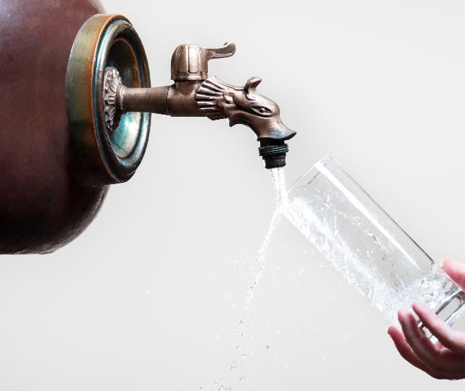
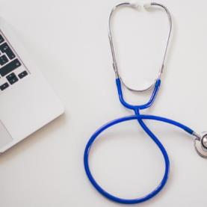
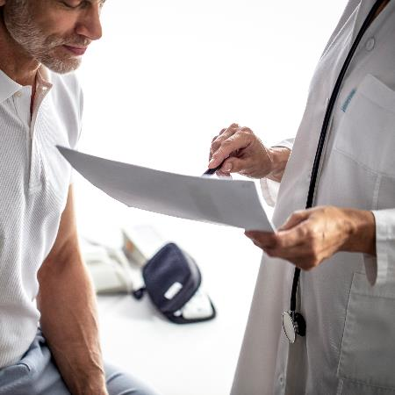
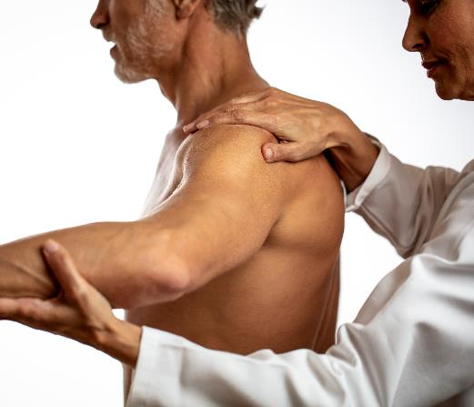
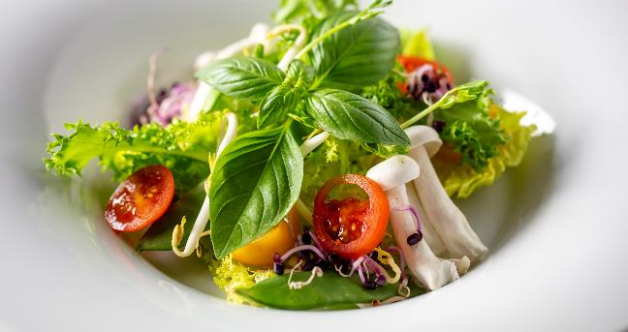
Our approach to health
Consultation at the start of the programme
Individual attention throughout your stay
Exercise agendas for optimal results
Opportunities to relax (days off during long stays)
Nutritional and life-style guidance
A pleasant hotel stay in the category you choose
Places of exceptional beauty and of historic elegance
Follow-up consultation (end of the programme)
Virtual meeting with the doctor after the stay

Slide 18
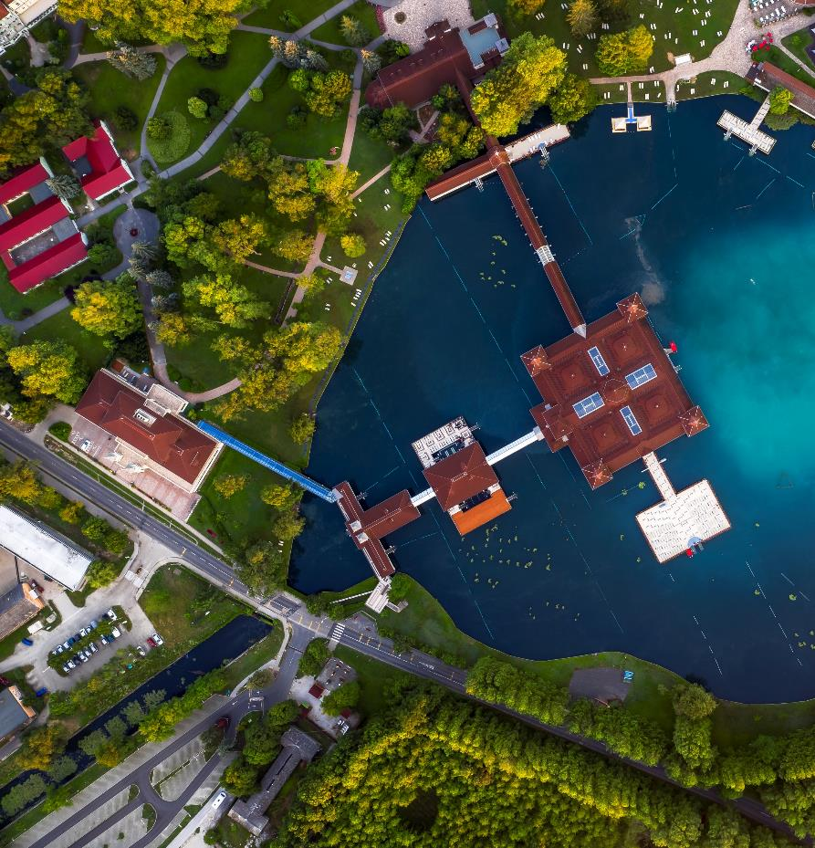
Health programmes
- Ensana’s signature health care therapies -
Aqua-Vital Re-Balance – rehabilitation in focus ( underwater treatments )
Global reputation for treating and reversing skin conditions - Smrdáky spa.
Special programmes in treating women’s gynecological complaints in Romania.
Strong focus on demonstating efficacy – Evidence Based Medicine
(all patients’ medical data is tracked)
„Enhanced Health Programmes” → healing the general health condition
Healthy in - program ( 2-6 nights )
Essential Spa - program ( minimum 5 nights )
Traditional Spa - program ( minimum 5 nights )
Intensive Spa program - ( minimum 7 nights )
All programs with medical check up

Slide 19
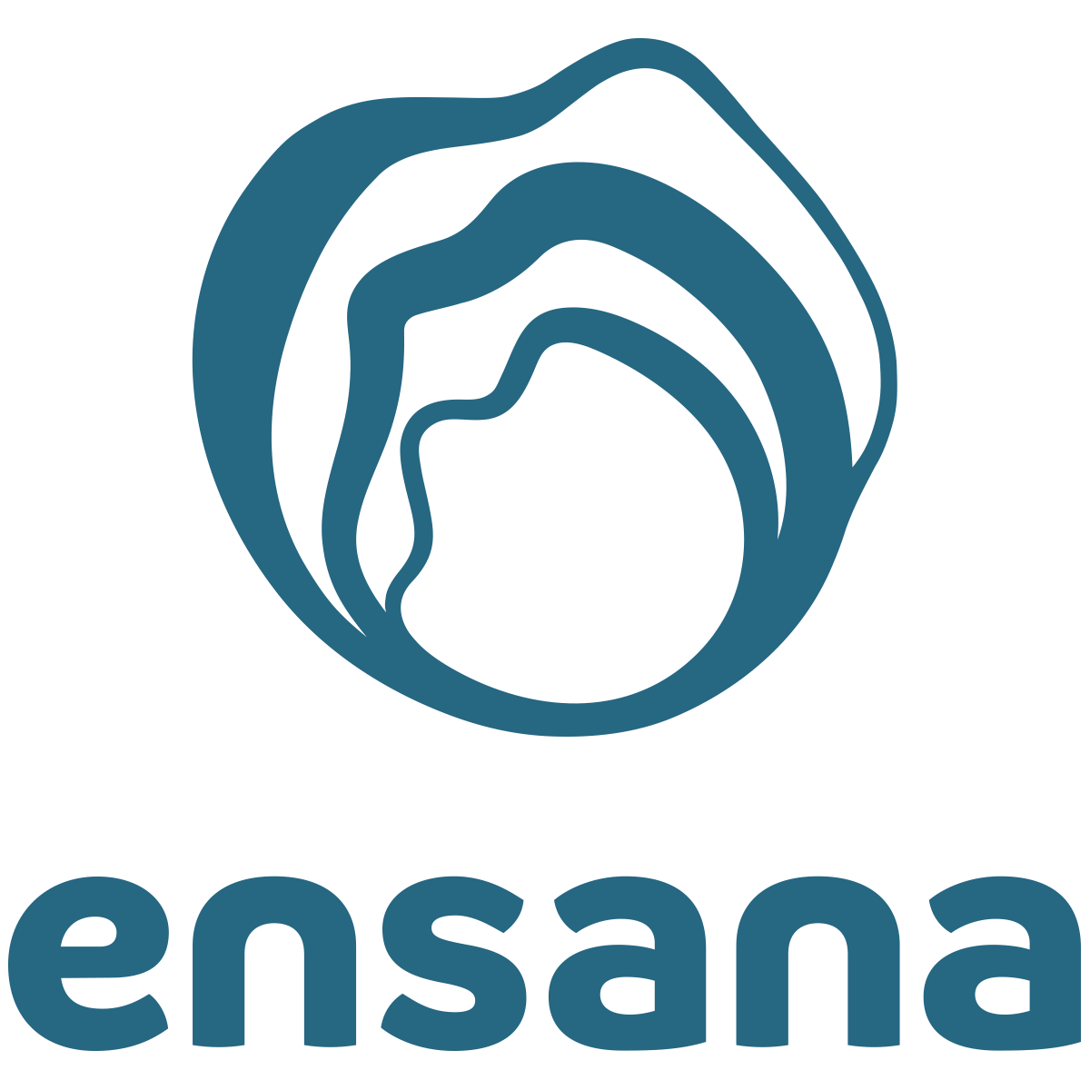
2026 - coming
Longevity by Nature

Slide 20
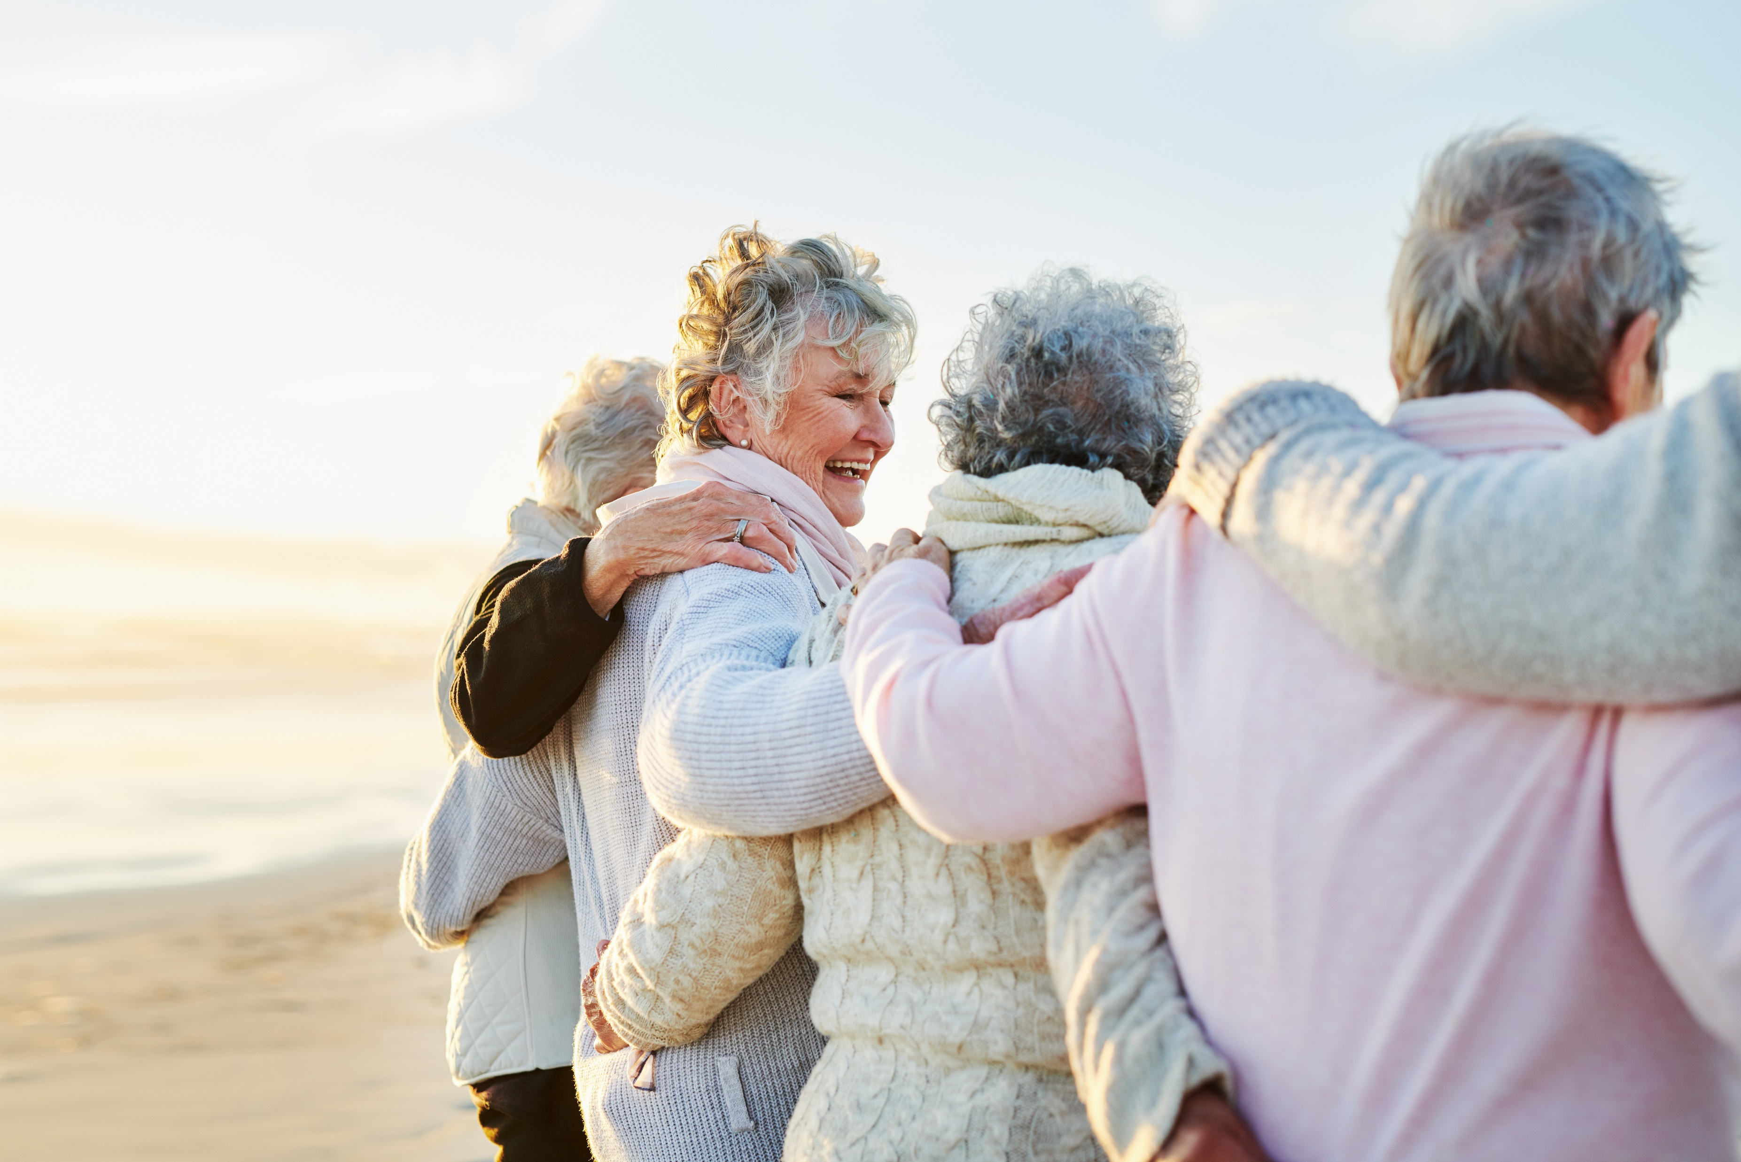
Longevity by Nature
The Ensana Longevity Program - Longevity by Nature merges advanced diagnostics, personalized therapies, and lifestyle medicine to extend guests’ healthspan.
Building on Healthy Aging and Medical Check-Up, it focuses on prevention, metabolic balance, and cognitive resilience. Through innovation and expert partnerships, Ensana leads in longevity-focused spa medicine.

Slide 21
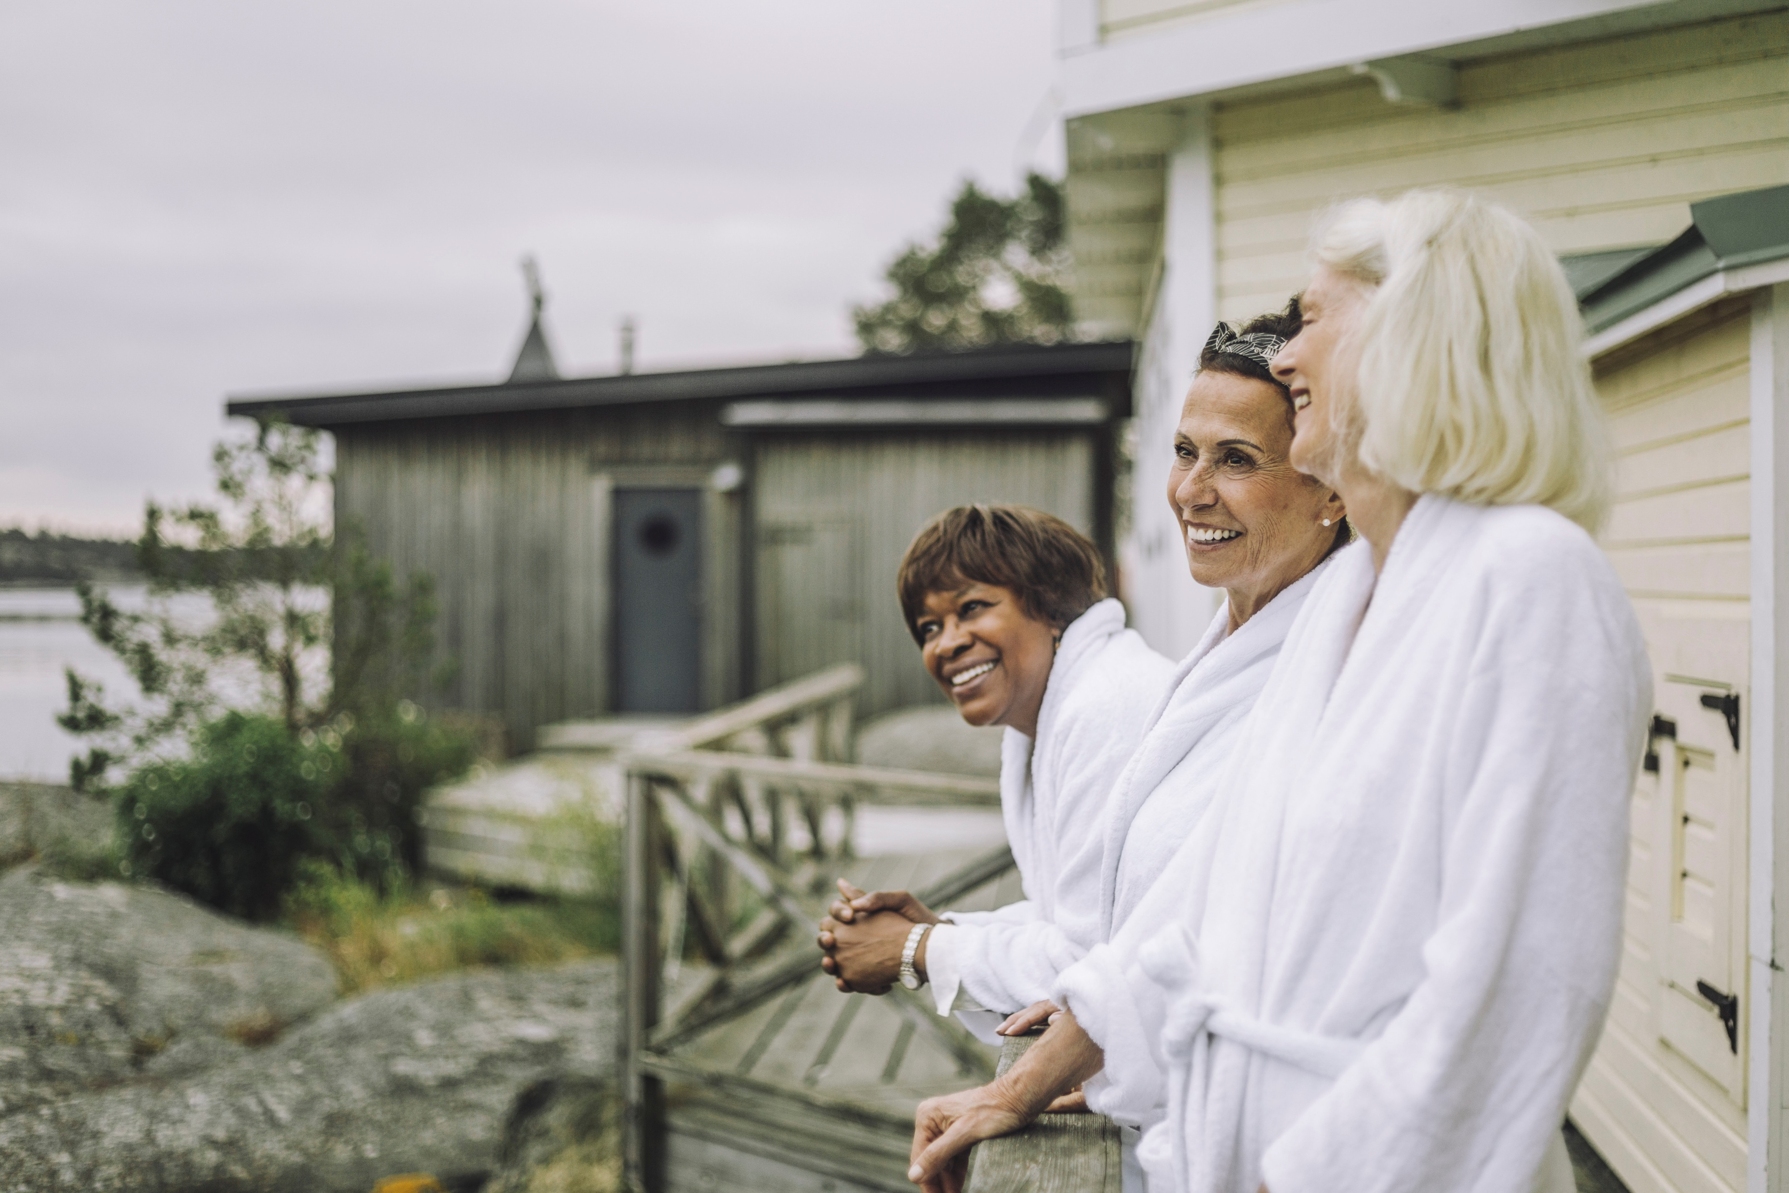
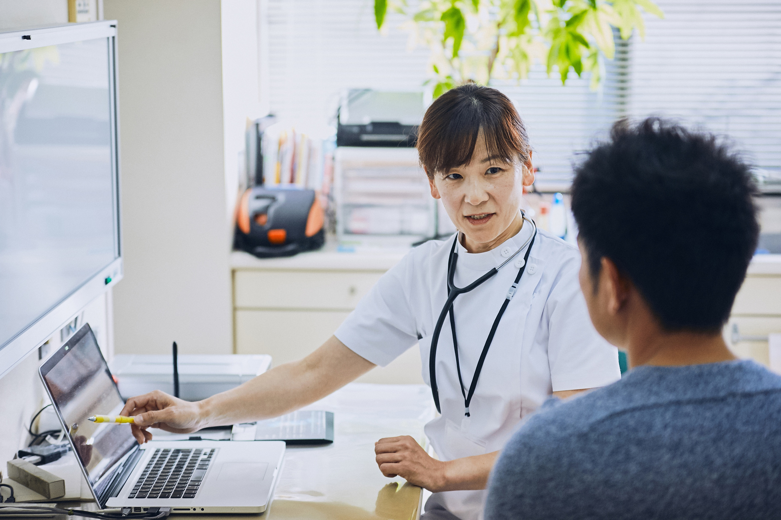
Longevity by Nature
Integrated approach: Combining diagnostics, personalized therapy, and lifestyle medicine.
Data-driven insights: DNA, hormone, and microbiome testing to guide tailored longevity plans.
Visible results: Improved metabolism, resilience, energy, and cognitive balance.
Holistic optimization: neurofeedback, nutrigenomics, and sleep therapy for stress resilience and long-term wellbeing.
Regenerative therapies: MLS Laser, red light therapy, cryotherapy, and IV infusions to restore vitality and cellular health.

Slide 22
Thank You!

